Slide 1
電腦視覺與深度學習 (Computer Vision and Deep Learning) Homework 2
TA:
Gmail: nckubot65904@gmail.com
Office Hour: 14:00~16:00, Mon.
10:00~12:00, Thu.
At CSIE 9F Robotics Lab.

Slide 2
Notice (1/2)
Copying homework is strictly prohibited!! Penalty: Both individuals will receive a score of 0!!
Due date ➔ 09:00:00, 2024/12/27 (Fri.)
Do not submit late, or the following points will be deducted:
Submit within seven days after the deadline, and your score will be reduced by half.
If you submit after this period, you will receive a score of 0.
You must attend the demonstration, otherwise your score will be 0. The demonstration schedule will be announced on NCKU Moodle.
You must create GUI, otherwise your point will be deducted.
Upload to ➔ 140.116.154.28 → Upload/Homework/Hw2
User ID: cvdl2024 Password: RL2024cvdl
Format
Filename: Hw2_StudentID_Name_Version.zip
Ex: Hw2_F71234567_林小明_V1.zip
If you want to update your file, you should update your version to be V2,
Ex: Hw2_F71234567_林小明_V2.zip
Content: Project folder *( Excluding the pictures )
*Note: Remove your “Debug” folder to reduce file size.

Slide 3
Notice (2/2)
Python (recommended):
Python 3.10
Matplotlib 3.8.0
UI framework: pyqt5 (5.15.11)
Torch 2.5.1
Torchvision 0.20.1
Torchsummary 1.5.1

Slide 4
Assignment Scoring (Total: 100%)
1. (50%) Training a CIFAR10 Classifier Using VGG19 with BN
1.1 (10%) Load CIFAR10 and show 9 augmented images with labels.
1.2 (10%) Load model and show model structure.
1.3 (15%) Show training/validating accuracy and loss.
1.4 (15%) Use the model with highest validation accuracy to run inference, show the predicted distribution and class label.
2. (50%) Training a MNIST Generator Using DcGAN
2.1 (10%) Load MNIST and show training images.
2.2 (10%) Load Model and show model structure.
2.3 (15%) Show training loss.
2.4 (15%) Show the real images and fake images using Generator.
(出題：Jun, Tim)
(出題：Neil, Alan)

Slide 5
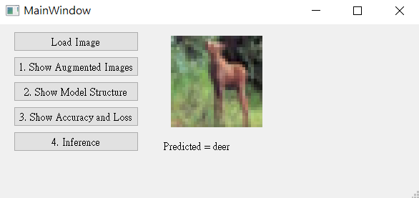
1. Training a CIFAR10 Classifier Using VGG19 with BN (50%)
1.1 Load CIFAR10 and show 9 augmented images with labels. (10%)
1.2 Load model and show model structure. (10%)
1.3 Show training/validating accuracy and loss. (15%)
1.4 Use the model with highest validation accuracy to run inference, show the predicted distribution and class label. (15%)
(出題： James, Tim)
Figure: GUI example

Slide 6
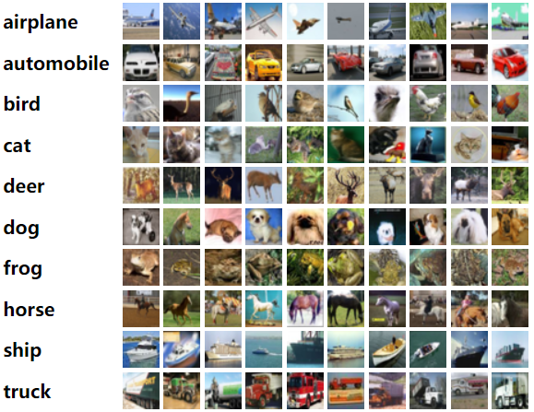
1. Training a CIFAR10 Classifier Using VGG19 with BN (50%)
Objective
Learn how to train a VGG19 with BN (Batch Normalization) model to classify 10 different classes images of CIFAR10.
VGG19 with BN
VGG19: A convolutional neural network that is 19 layers deep.
BN (Batch Normalization): used to make training of artificial neural networks faster and more stable.
CIFAR10
A collection of 60,000 32x32 color images in 10 different classes that is commonly used to train machine learning and computer vision algorithms.
10 classes: airplane, automobile, bird, cat, deer, dog, frog, horse, ship, truck
Datasets
Training dataset: 50000 images in total.
Validation dataset: 10000 images in total.
Testing dataset: 10 images in total. (Generating from validation dataset.)
(出題： James, Tim)
Figure1: CIFAR10
R. Reference
VGG19
Batch Normalization

Slide 7
1. Training a CIFAR10 Classifier Using VGG19 with BN (50%)
Requirements
Train VGG model with batch normalization (BN) using PyTorch.
In the submitted file, you need to include
Weight file for VGG19 with BN in .pth format. (File size is approximately 540MB)
Figure of training/validating loss and accuracy in .jpg or .png format.
Code for your GUI program
Code for model training.
Please do not include image data in the submitted file.
Homework Images
There are 2 different folders in ‘Q1_image’.
In the subfolder ‘Q1_image/Q1_1,' there are 9 different images used in Q1-1. When demoing, use the same images.
In the subfolder ‘Q1_image/Q1_4,' there are 9 different images used in Q1-4. These images are used for testing your program. When demoing, we will use different images for the demonstration.
(出題： James, Tim)

Slide 8
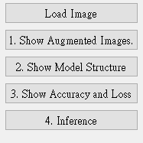
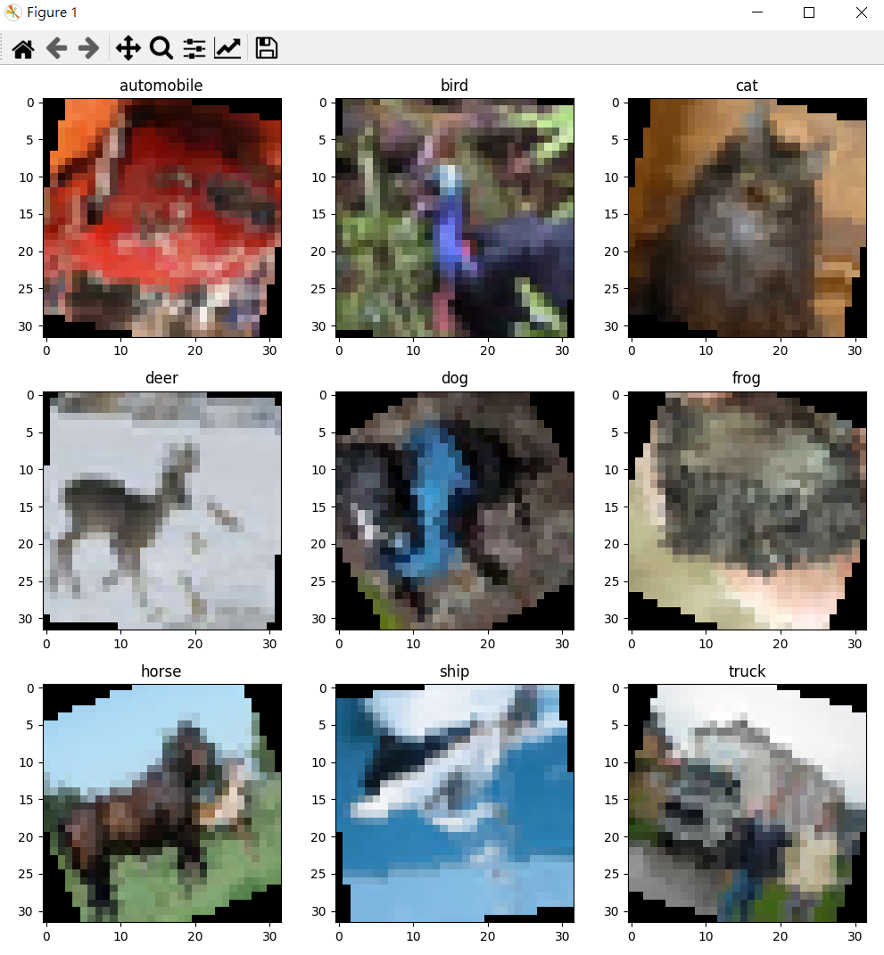
1.1 Show 9 Augmented Images with Labels (10%)
Q1.1
At home:
Use PIL.Image.open() form Pillow package to load 9 images in /Q1_image/Q1_1/ folder.
Apply at least 3 different type of data augmentation (tutorial).
transforms.RandomHorizontalFlip()
transforms.RandomVerticalFlip()
transforms.RandomRotation(30)
When the demo:
Click the button “1. Show Augmentation Images”
Load 9 images in /Q1_image/Q1_1/ folder
Apply data augmentation on 9 images.
Show 9 augmented images with label in a new window.
(出題： James, Tim)
Notice: This is an example; you can use different data augmentation techniques
Figure1: 9 Augmented images Notice: this is an example, the
images might differ

Slide 9
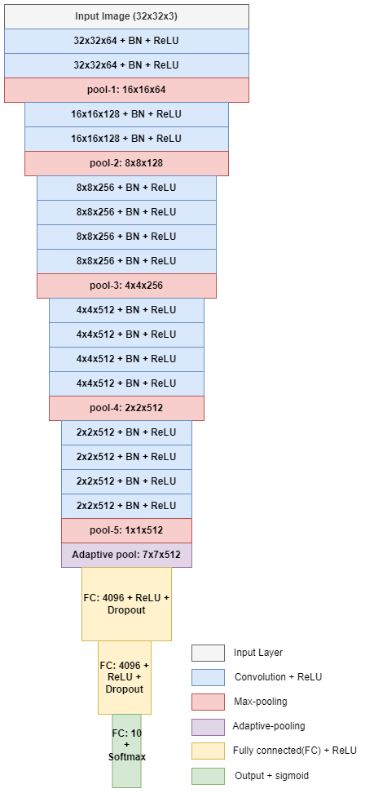
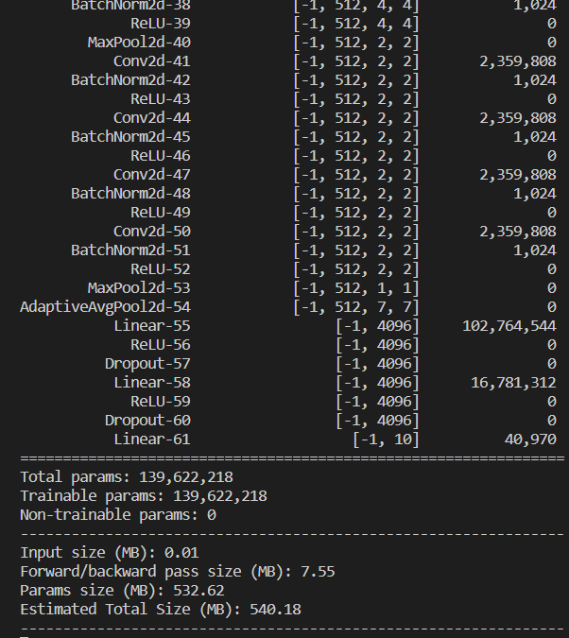
1.2 Show the Structure of VGG19 with BN (10%)
(出題：Jun, Tim)
Q1.2
At home:
Use torchvision.models.vgg19_bn(num_classes=10) to build a VGG19 with batch normalization (BN) model.
Use torchsummary.summary to show the structure in the terminal.
When the demo:
Click the button “2. Show Model Structure”
Run the function to show the structure in the terminal.
The -1 indicates that the actual size of batch size can vary.
Feature map shape
(Batch, Channels,
Height, Width)
Layer (type)
Num. of param.
All convolution filter size is 3x3
(1)
(2)
(3)
(1)
(2)
(4)
(3)
(4)
(5)
(5)
Flatten Here
FC: Fully Connectional Network
Figure: the Structure of VGG19 with BN
Figure: VGG19 with BN model structure

Slide 10
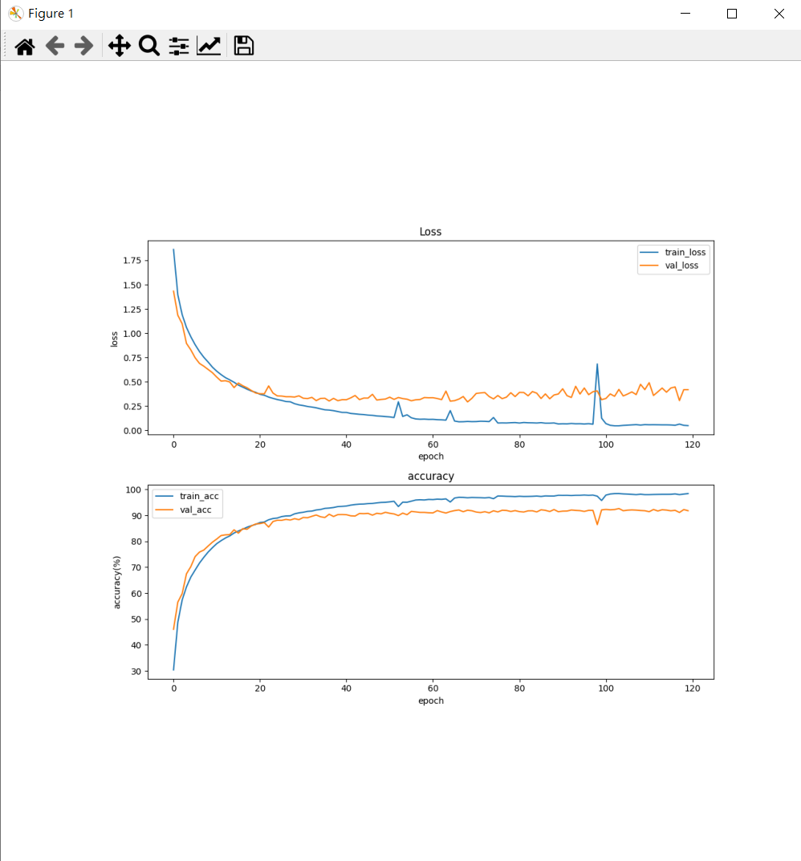
1.3 Show Training/Validating Accuracy and Loss (15%)
Q1.3
At home:
Use torchvision.datasets.CIFAR10 to load the training and validation datasets. (tutorial)
Training and validating VGG19 with BN at least 40 epochs at home (tutorial) and record the training/validating accuracy and loss in each epoch (tutorial).
Notice: If your validation accuracy is low, you can try
Adjust the learning rate of the optimizer.
Change the data augmentation techniques used.
Save weight file with highest validation accuracy .
Use matplotlib.pyplot.plot() to create a line chart for the training and validating loss and accuracy values.
Save the figure in .jpg or .png format.
When the demo:
Click the button “3. Show Accuracy and Loss”
Show the saved figure of Training/Validating loss and accuracy in a new window
(出題： James, Tim)
(2) Show the figure in a new window
(1) Click the button.
Notice: this is an example, the number of epoch might differ

Slide 11
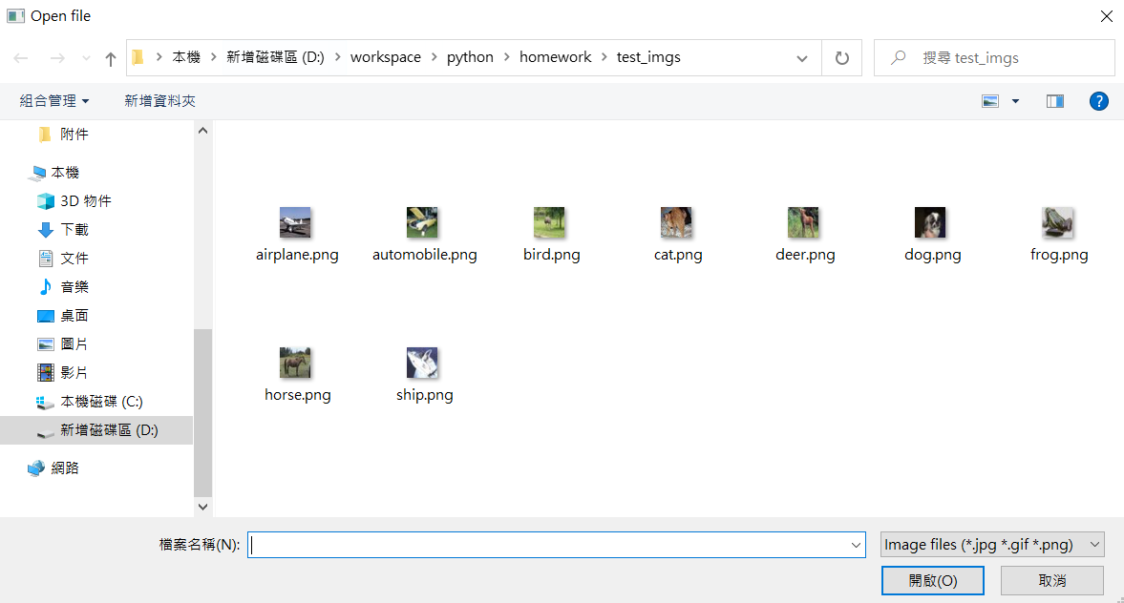
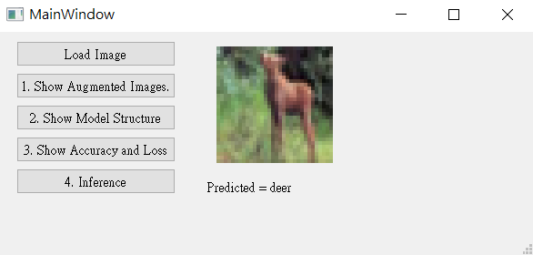
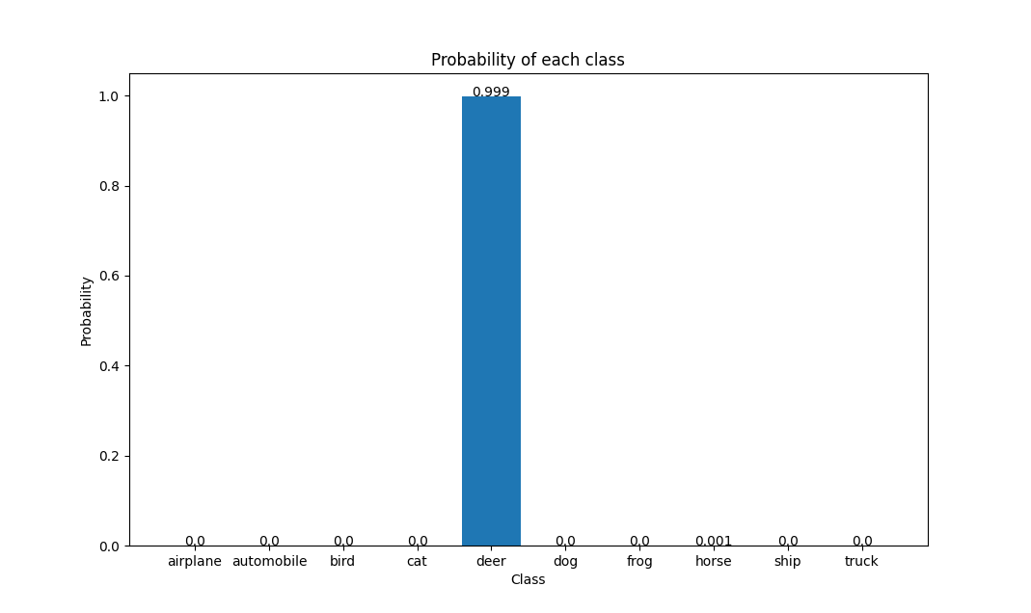
1.4 Use the Model with Highest Validation Accuracy to Run Inference, Show the Predicted Distribution and Class Label. (15%)
(出題： James, Tim)
Q1.4
At home:
Load the model which trained at home
Click the button “Load Image” to display a new file selection dialog
Select 1 image arbitrarily.
Show the loaded image on the GUI. (In order to make it visually clear on the UI, use QtGui.Qpixmap.scaled to scale the image to 128x128 when displaying it.)
Click the button “4. Inference” to run inference on the image. (use softmax function) (tutorial)
Show the predicted class label on the GUI.
Show the probability distribution of model predictions using a histogram in a new window.
When the demo: repeat the process
(3) Select 1 image arbitrarily
(2) Click the button.
(4) Show the loaded image (When displaying loaded image, resizing the loaded image to 128x128)
(6) Show the predicted class label
(5) Run inference on the loaded image
(7) Show the probability distribution of the model predictions in a new window.
(Adding the probability value to each bar of the plot is necessary.)

Slide 12
1.4 Use the Model with Highest Validation Accuracy to Run Inference, Show the Predicted Distribution and Class Label. (15%)
The probability distribution of model prediction using a histogram.
(出題： James, Tim)
Y-axis: probability
X-axis: class name

Slide 13
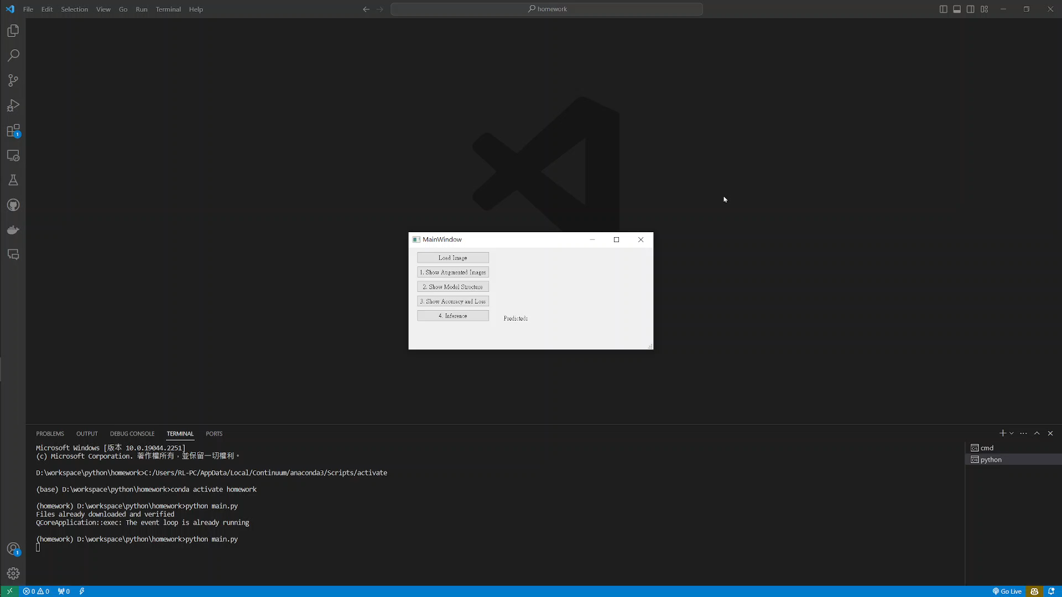
1. Training a CIFAR10 Classifier Using VGG19 – Example Video
(出題： James, Tim)
This is an example illustrating the objectives from 1.1 ~ 1.4.

Slide 14
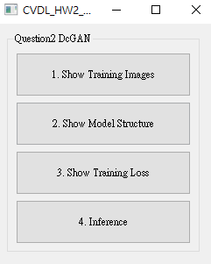
2. Training a MNIST Generator Using DcGAN (50%)
(出題：Neil, Alan)
2.1 Load MNIST to show training images and augmented training images. (10%)
2.2 Load model and show model structure. (10%)
2.3 Show training loss. (15%)
2.4 Show the real images and fake images using Generator. (15%)
Fig.1 GUI example

Slide 15

2. Training a MNIST Generator Using DcGAN (50%)
(出題：Neil, Alan)
Objective
Learn how to train a DcGAN (Deep Convolution Generative Adversarial Network) model to generate handwritten digits images of MNIST.
DcGAN
A convolutional neural network that is made of a Generator and a Discriminator.
Generator: Aim to spawn ‘fake’ images that look like the training images.
Discriminator: Aim to look at an image and output whether or not it is a real training image or a fake image from the generator.
MNIST
A collection of 70,000 handwritten digits (0-9), with each image being 28x28 pixels, each pixel value (0-255) represents the grayscale intensity of the corresponding pixel in the image.
Training dataset: 60,000 images in total.
Testing dataset: 10,000 images in total.
R. Reference: DcGAN
Fig.2 MNIST datasets

Slide 16
2. Training a MNIST Generator Using DcGAN (50%)
(出題：Neil, Alan)
Requirements
Train DcGAN model using PyTorch.
In the submitted file, you need to include
Weight file for DcGAN in .pth format. (File size is approximately 13.6MB for Generator & 10.5MB for Discriminator)
Figure of training loss in .jpg or .png format.
Code for your GUI program
Code for model training.
Please do not include image data in the submitted file.
Homework Images
There is one folder in ‘Q2_image’.
In the subfolder ‘Q2_image/mnist,' there should have 70,000 images (18.3 MB) in the folder. When do the training, use those images.
The folder structure shown as below:
Q2_image/
└── mnist/
├── test_0_60003.png
├── test_0_60010.png
...
└── train_9_59992.png

Slide 17
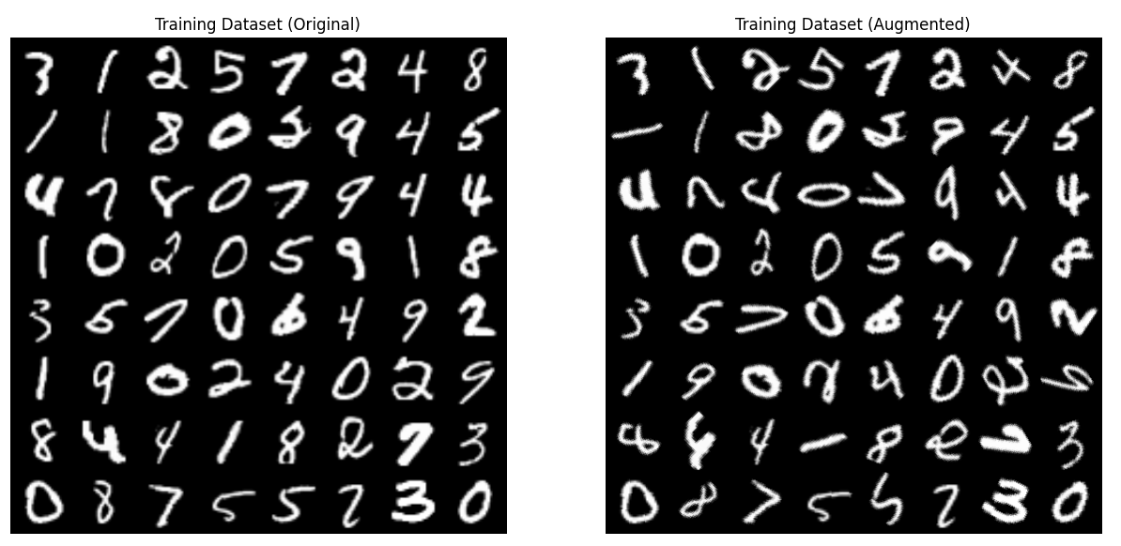
2.1 Load MNIST to Show Training Images and Augmented Training Images (10%)
(出題：Neil, Alan)
Q 2.1
At home:
Use dest.ImageFolder(root=dataroot, transform=transforms.Compose([…])) at torchvision to load MNIST dataset /Q2_image/mnist/ folder. (tutorial)
Apply at least 1 different type ofdata augmentation (tutorial).
transforms.RandomRotation(60)
When the demo:
Click the button “1. Show Training Images”
Load MNIST dataset /Q2_image/mnist/ folder
Apply data augmentation on training images.
Show 64 original training data and 64 augmented training data in a new window.
Dataset’s path
Data preprocess (includes resize, augmentation, …)
Notice: this is an example. You can use different data augmentation techniques.
degree
Fig.3 Training images from mnist dataset
Notice: this is an example, the images might be different

Slide 18
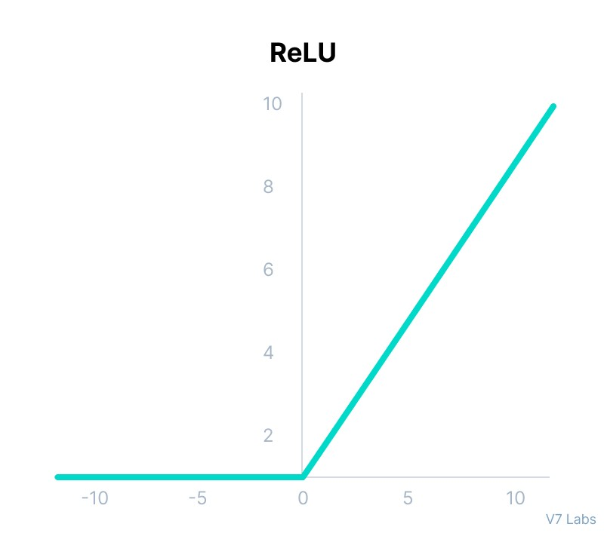
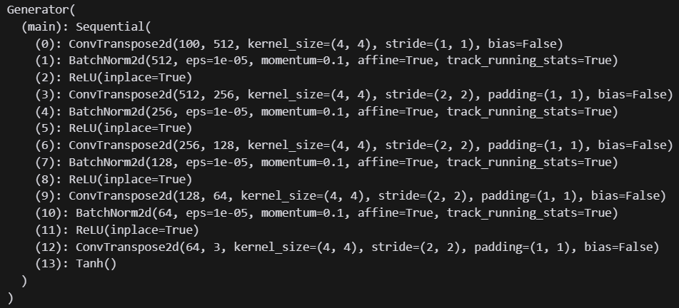
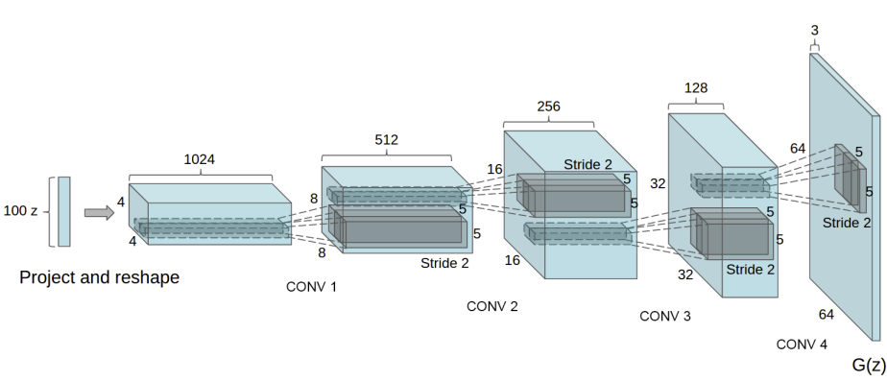
2.2 Load Model and Show Model Structure (10%) (1/2)
(出題：Neil, Alan)
Q 2.2 – Generator (tutorial) (5%)
At home:
Use netG = Generator(ngpu).to(device) to build the Generator model into gpu or cpu.
Use netG.apply(weights_init) to apply initial weight into Generator.
Use print(netG) to print the Generator structure. (Fig.4.2)
When the demo:
Click the button “2. Show Model Structure”
Run the function to show the 2 structures in the terminal.
i/p channels
o/p channels
(12), (13)
Bias in weights
(9), (10), (11)
(6), (7), (8)
Prevent small values that divide by zero
(0), (1), (2)
(3), (4), (5)
Computing the moving average of mean and variance
Learnable affine parameters (scale and shift)
Tracks the running mean and variance during training
Fig.4.1 DcGAN Generator model structure visualize
Fig.4.2 DcGAN Generator model structure

Slide 19
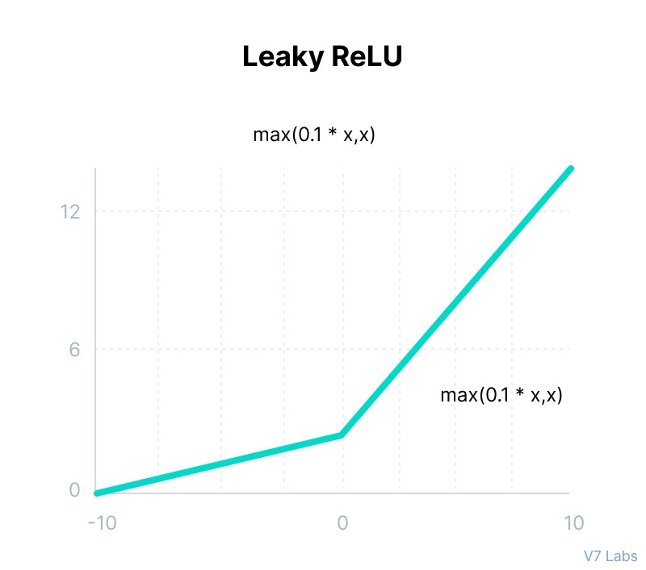
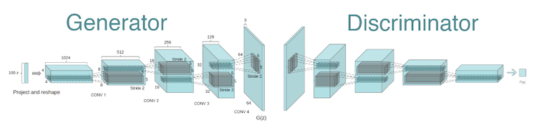
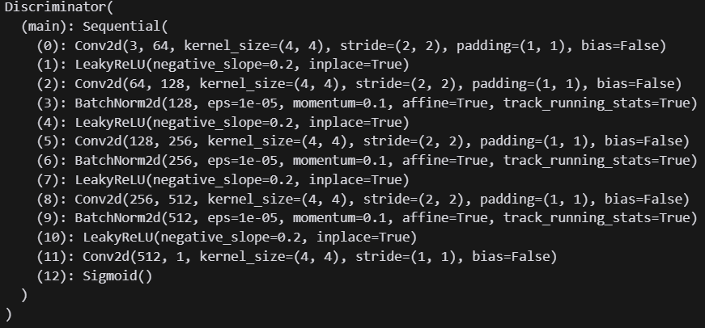
2.2 Load Model and Show Model Structure (10%) (2/2)
(出題：Neil, Alan)
Q 2.2 – Discriminator (tutorial) (5%)
At home:
Use netD = Discriminator(ngpu).to(device) to build the Discriminator model into gpu or cpu.
Use netD.apply(weights_init) to apply initial weight into Discriminator.
Use print(netD) to print the Discriminator structure. (Fig.5.2)
When the demo:
Click the button “2. Show Model Structure”
Run the function to show the 2 structures in the terminal.
The slope of the activation function for the negative input values
(0), (1)
i/p
o/p
(2), (3), (4)
Modifies the input tensor in-place to save memory
(5), (6), (7)
(8), (9), (10)
(11)
(12)
1.0 Real Image
0.0 Fake Image
Fig.5.1 DcGAN Discriminator model structure
Fig.5.2 DcGAN Discriminator model structure visualize

Slide 20
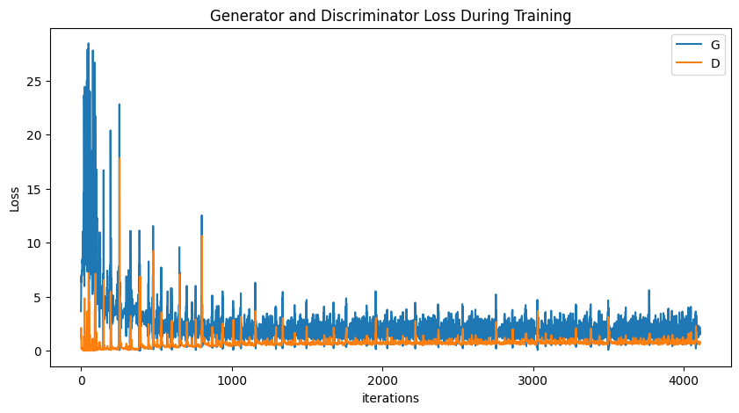
2.3 Show Training Loss (15%) (1/2)
(出題：Neil, Alan)
Q 2.3 (reference as DcGAN tutorial)
At home:
Load the training dataset as Q 2.1.
Training DcGAN at least 10 epochs at home (tutorial) and record the training loss in each epoch (tutorial).
Notice: If your loss is too high, you can try
Adjust the learning rate of the optimizer.
Change the data augmentation techniques used.
Save weight file (.pth) with lowest Generator loss. (how to save and load model in pytorch?)
Use plt.plot(G_losses, label=“G”) & plt.plot(D_losses, label=“D”) to create a line chart for the Generator and Discriminator loss during training values (tutorial).
Save the figure.
When the demo:
Click the button “3. Show Training Loss”.
Show the saved figure of Generator and Discriminator loss during training in a new window.
Notice: this is an example, the number of iterations might differ
Fig.6 images for the Generator and Discriminator loss during training

Slide 21
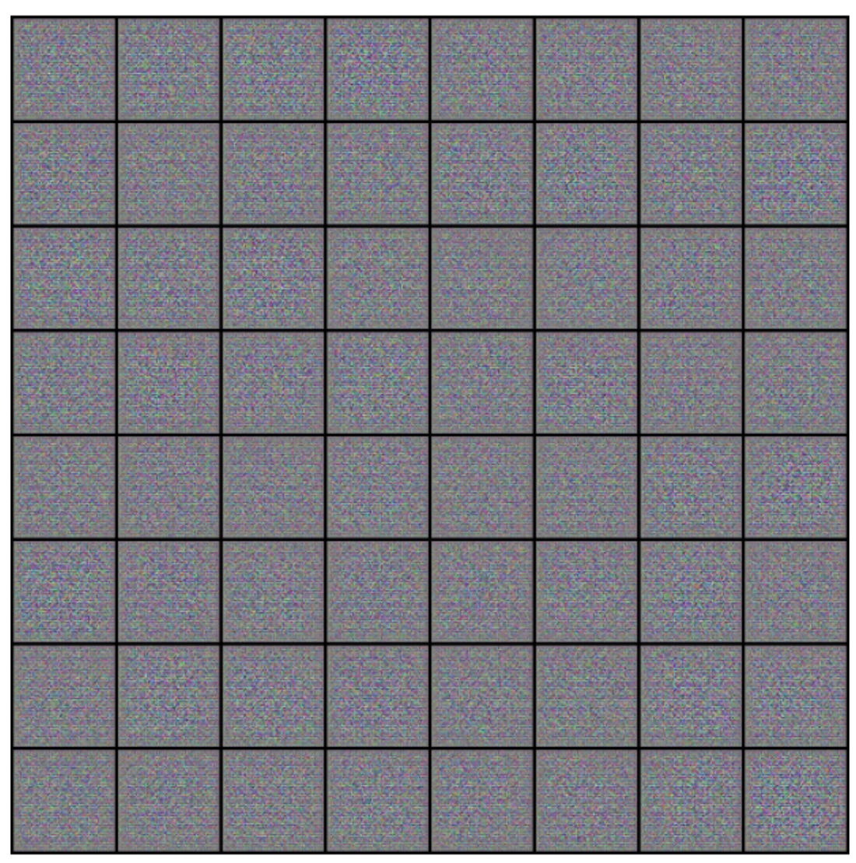
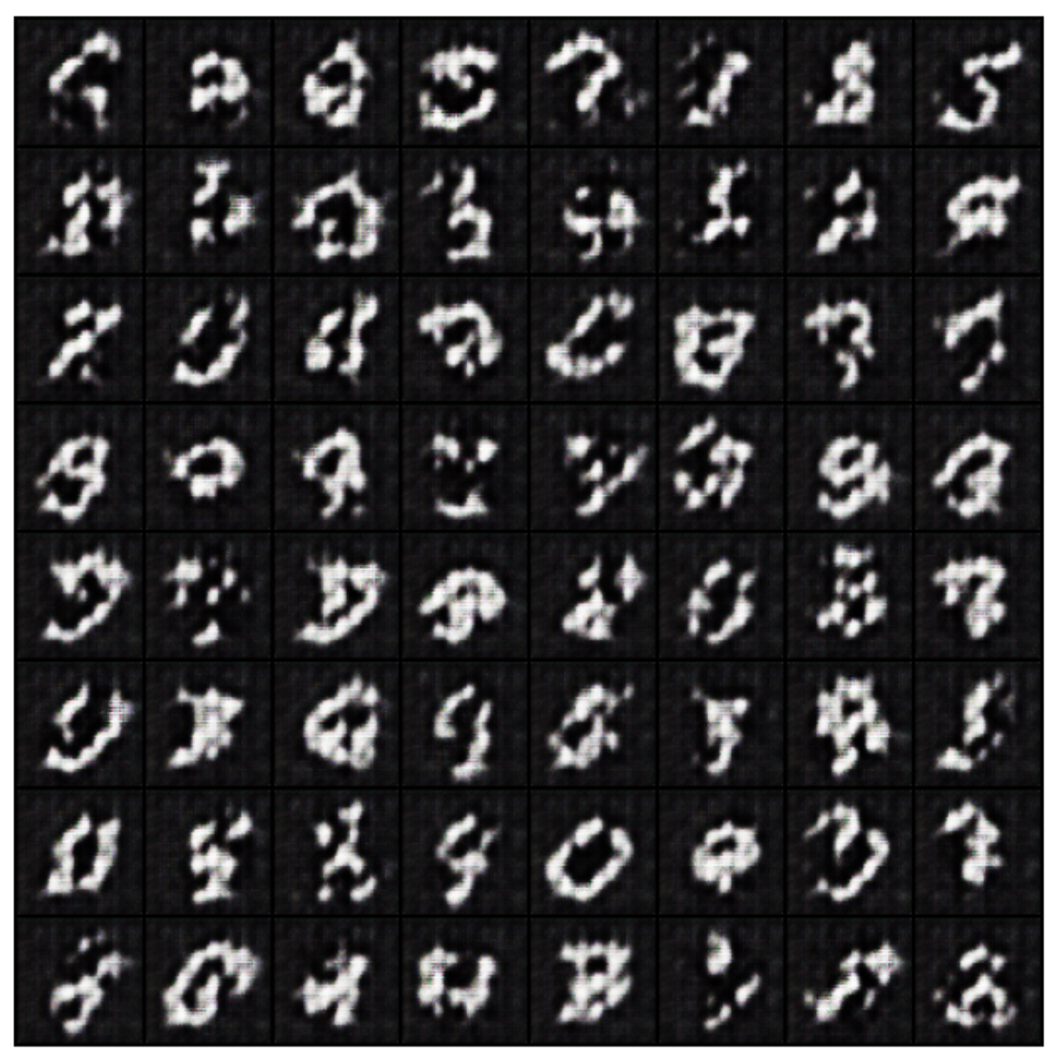
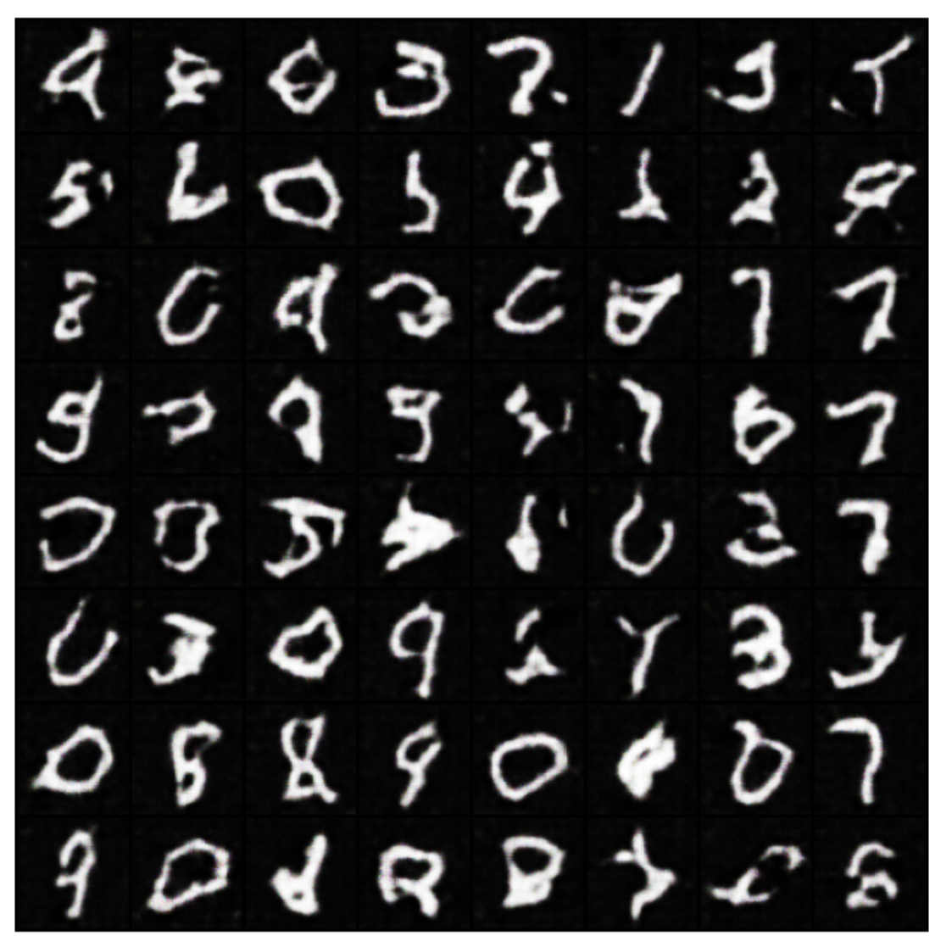
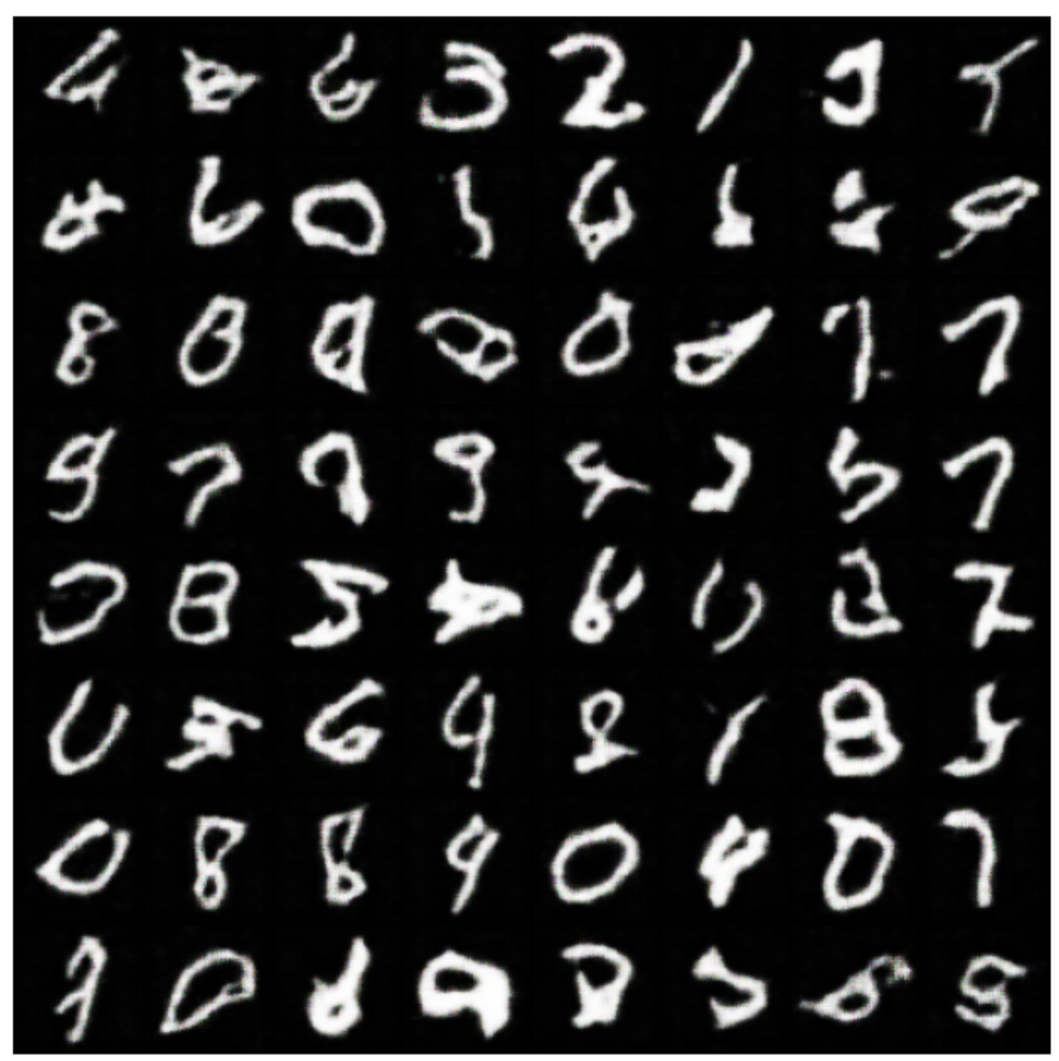
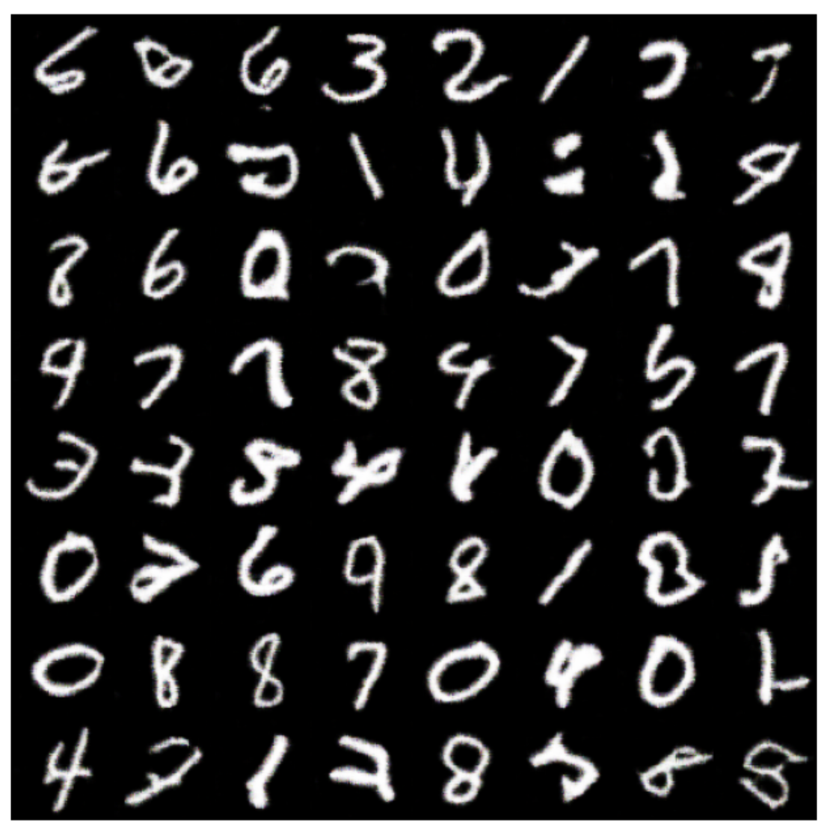
2.3 Show Training Loss (15%) (2/2)
(出題：Neil, Alan)
Fig.6 images for the Generator and Discriminator loss during training

Slide 22
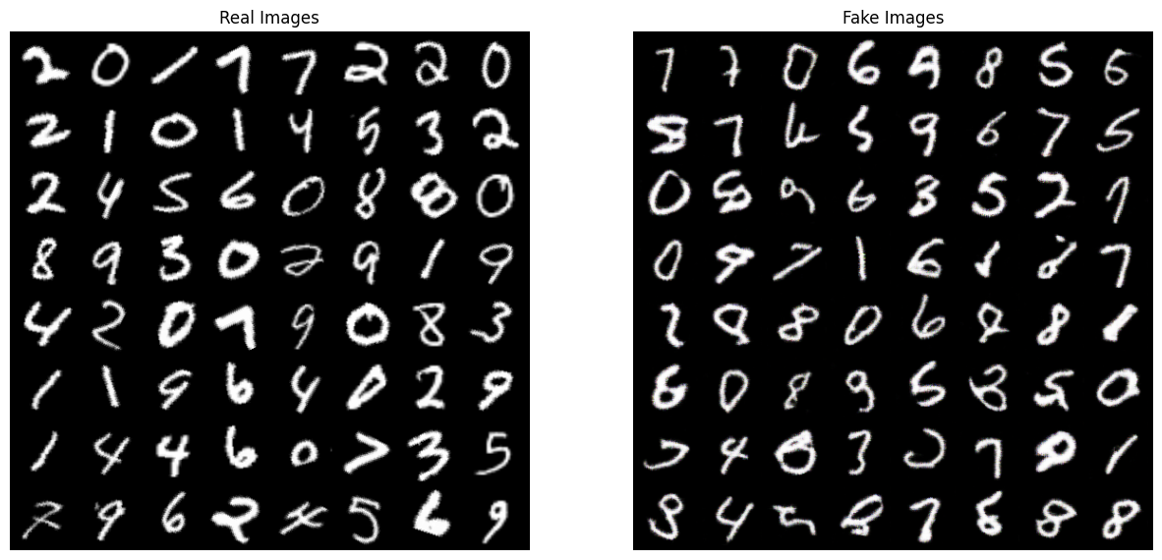
2.4 Show the Real Images and Fake Images Using Generator (15%)
(出題：Neil, Alan)
Q 2.4
At home:
Load the .pth model which trained at home. (how to save and load model in pytorch?)
Click the button “4. Inference” to run inference on the image.
Remember you need to load dataset like Q 2.1, load model structure like Q 2.2.
Show the loaded image on the GUI. (Fig.6)
When the demo: repeat the process
Fig.7 Show Real and Fake images via Generator

Slide 23
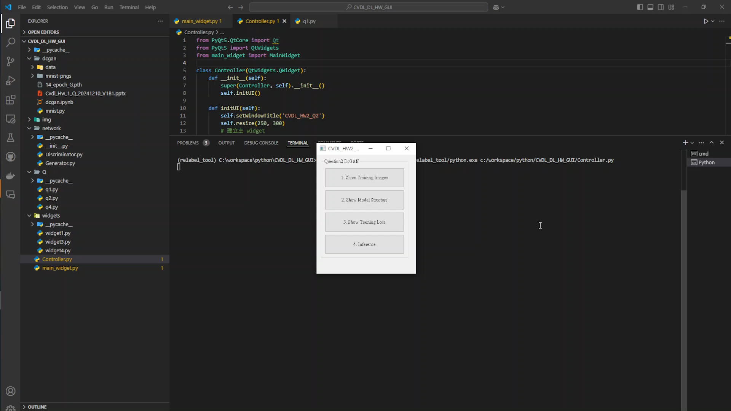
2. Training a MNIST Generator Using DcGAN - Example Video
This is an example illustrating the objectives from Q 2.1 ~ 2.4.
(出題：Neil, Alan)

